Slide 1

DetectiveMask
Intelligent mask detection platform
Group 26 (3Musketeers):
Hong Xiaohui, SXXXX943D, imhongxiaohui@gmail.com
Anita Koo Shi Qi, SXXXX480B, anita.koo@ncs.com.sg
Sanjeven Ramakrishnan, SXXXX938E, sanjeven.ramakishnan@ncs.com.sg

Slide 2
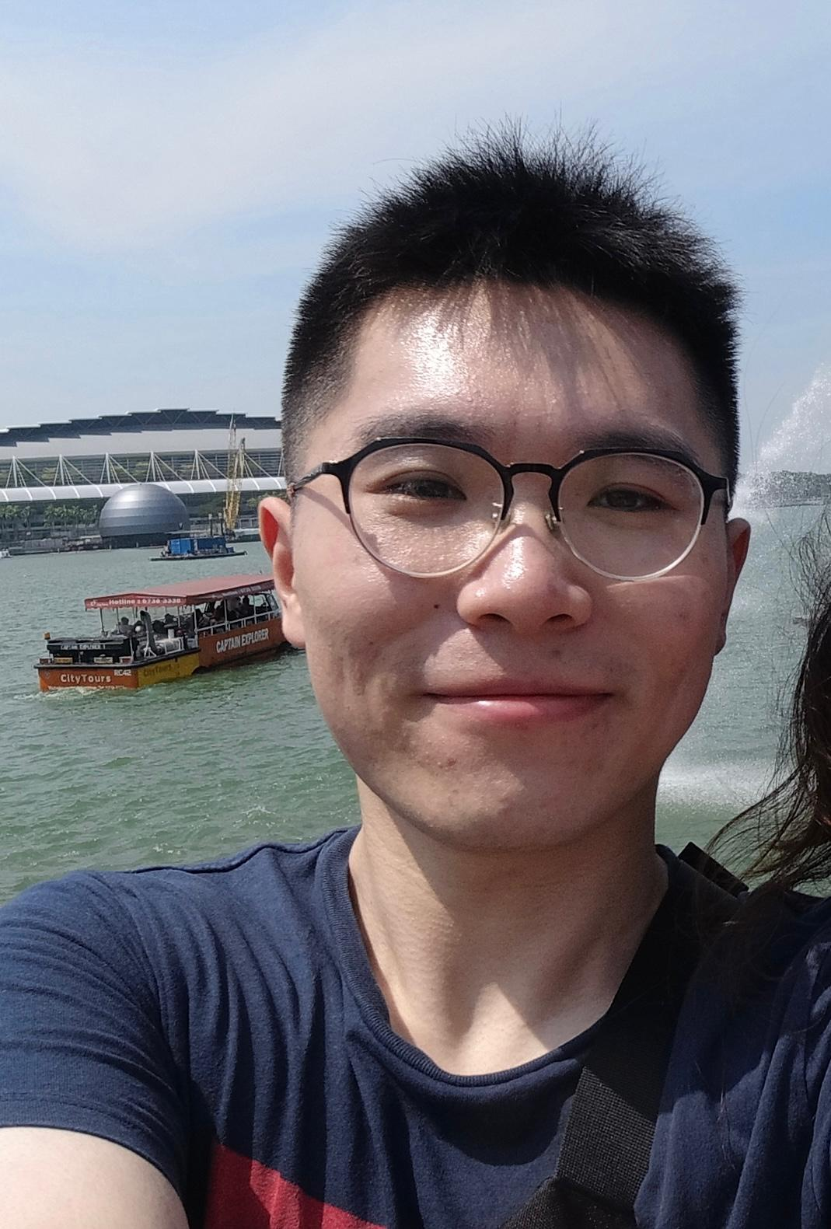
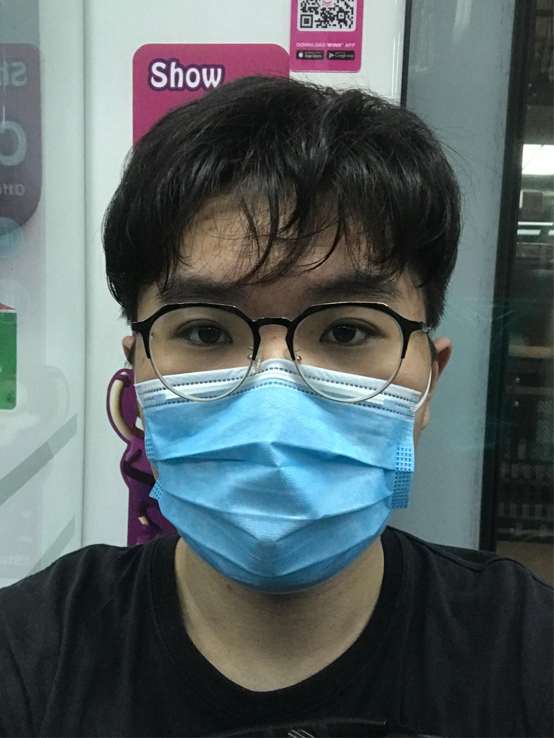
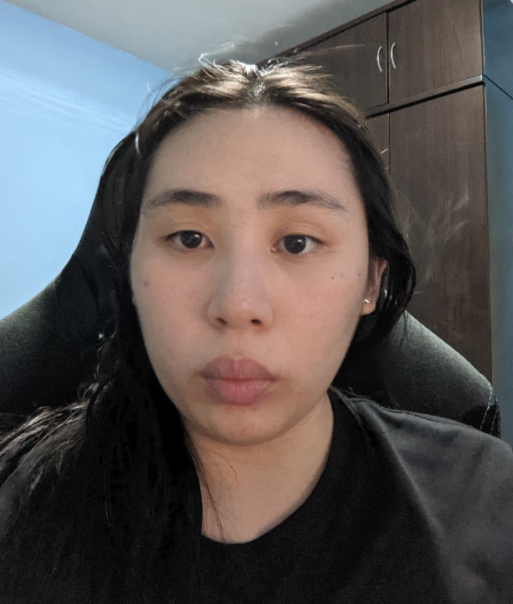
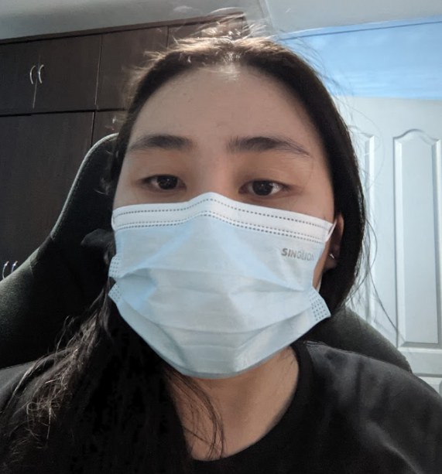
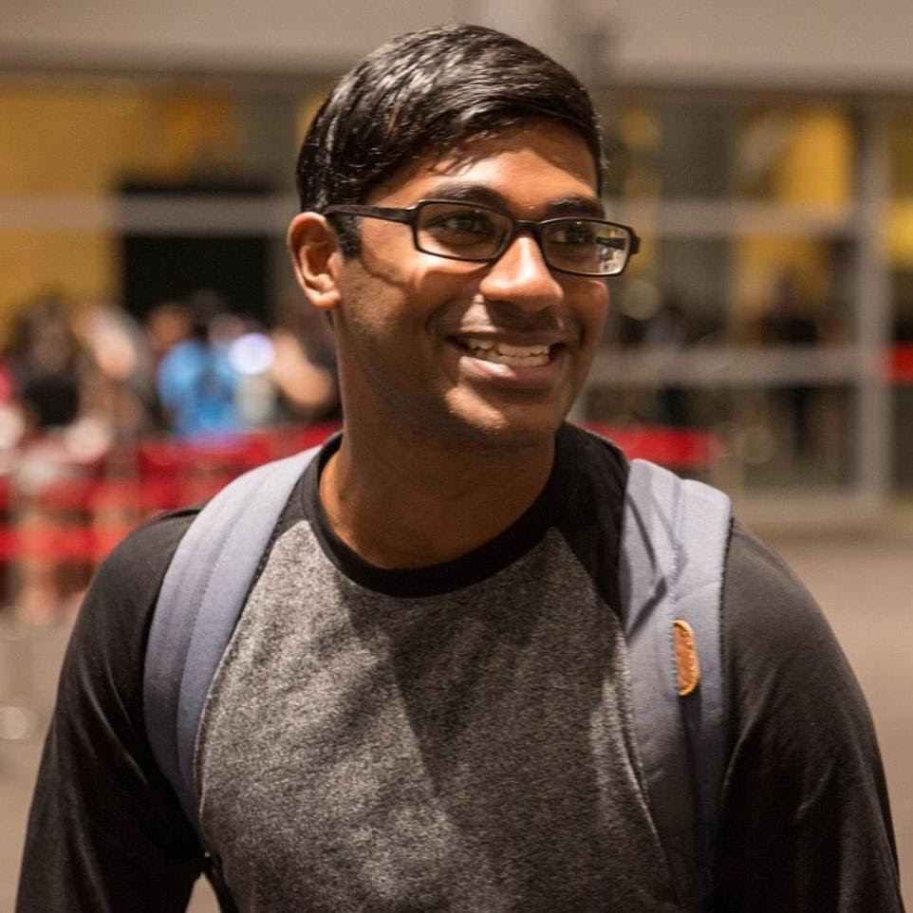
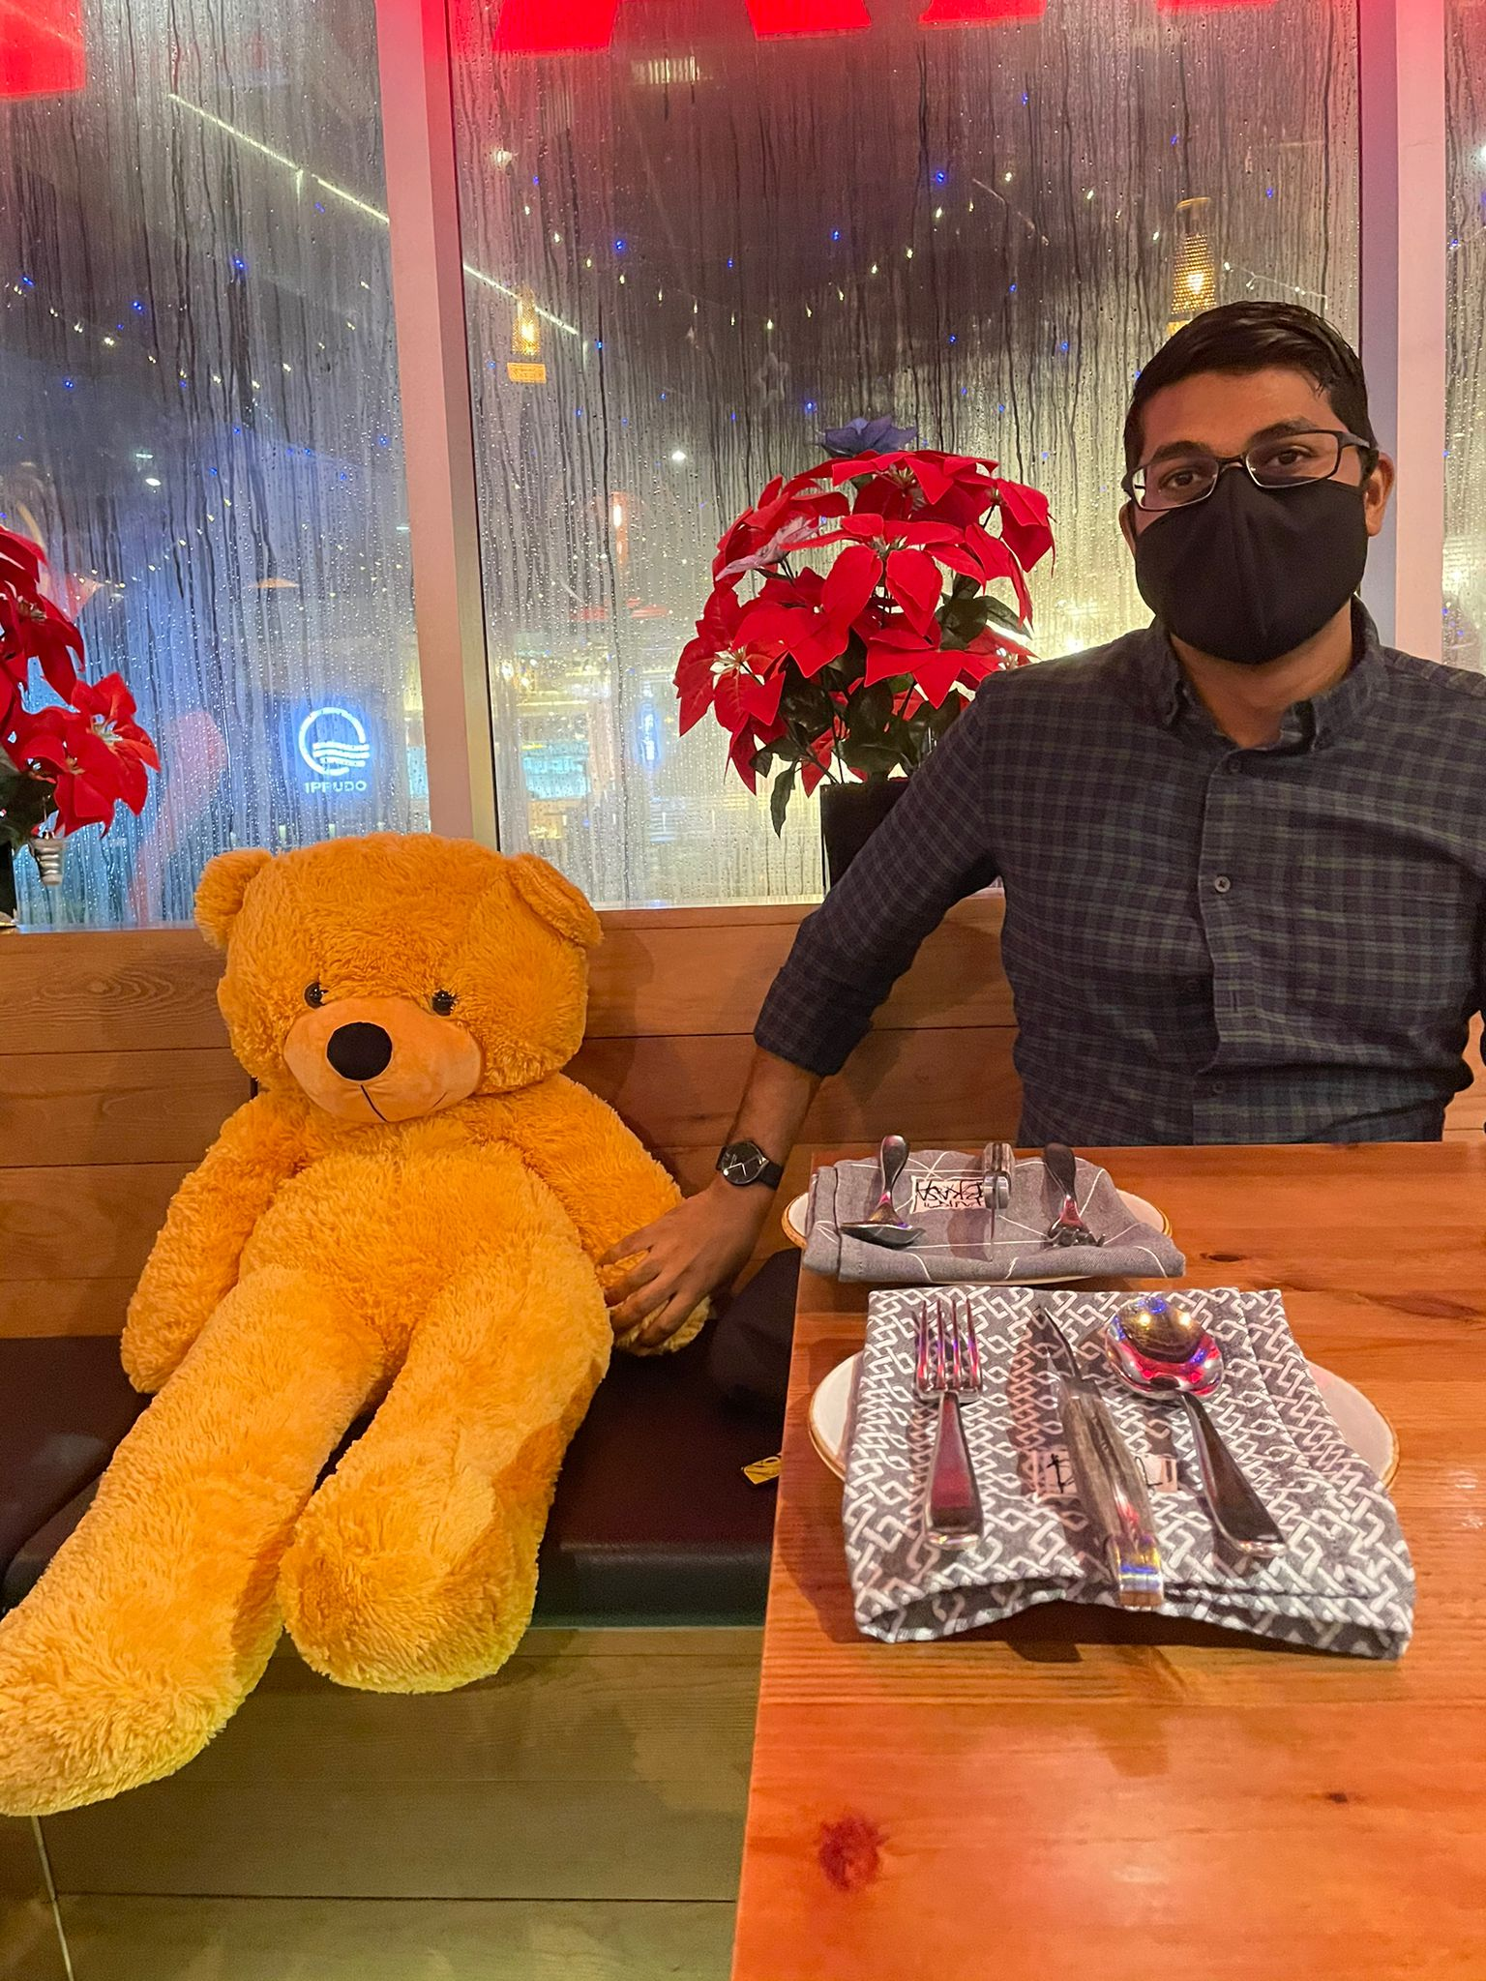
OUR TEAM
Without Mask
With Mask
Without Mask
With Mask
Without Mask
With Mask
Hong Xiaohui
Anita Koo Shi Qi
Sanjeven Ramakrishnan
SXXXX943D
imhongxiaohui@gmail.com
SXXXX480B
anita.koo@ncs.com.sg
SXXXX938E
sanjeven.ramakishnan@ncs.com.sg

Slide 3
TABLE OF CONTENTS
01.
02.
03.
04.
05.
06.
Objectives
Data Source
Technology
The goals of our project
The details of the data resources required/available
Techniques/tools used
Model
Features
Demo
Model used
Features of our application
Demo of our application

Slide 4
OBJECTIVE
To create an application to aid health enforcement officials to carry out their duty by providing notifications and alerts when a breach is detected

Slide 5
BENEFITS OF OUR SOLUTION
STREAMLINE
MANPOWER
Can be redeployed to serve our community better
Streamline the process of detecting people who do not comply with regulations
SWIFT ACTION
VERSATILE
System can be deployed in different scenarios
Allows authorities to take swift action to kerb the spread of the virus

Slide 6
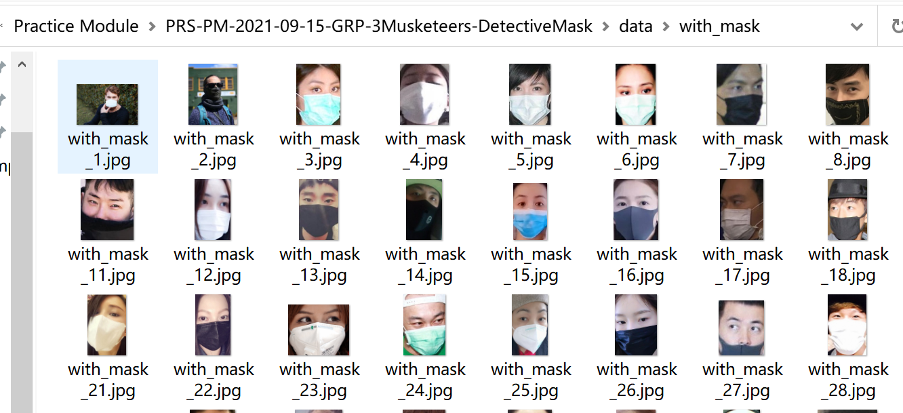
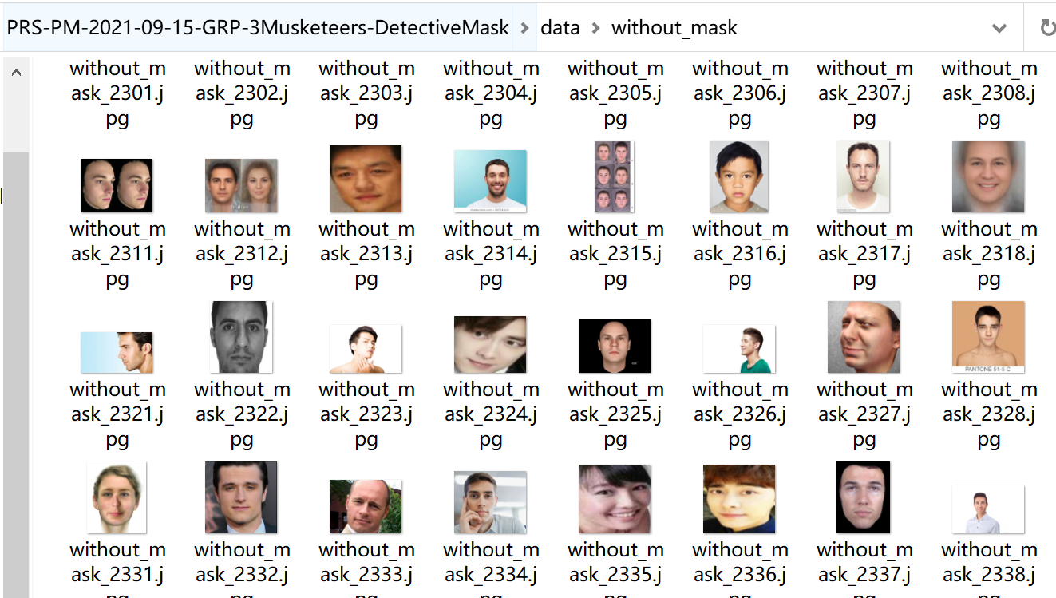
DATA SOURCE
Data set consists of 7553 RGB images in 2 folders as withmask and withoutmask.
Images are named as label with_mask and without_mask.
Images of faces with mask are 3725 and images of faces without mask are 3828.
https://www.kaggle.com/omkargurav/face-mask-dataset

Slide 7
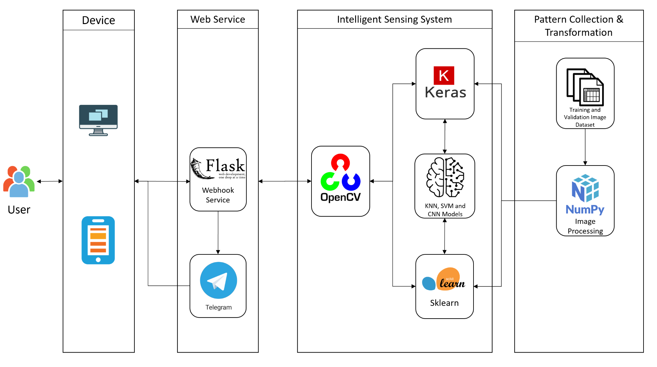
TECHNOLOGY
Algorithms: KNN, SVM and CNN

Slide 8
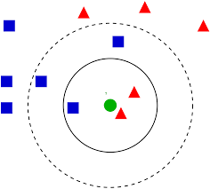

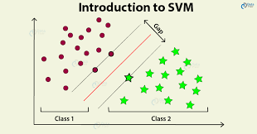
Model
KNN, SVM and CNN
Metric Used: Accuracy, F1 score and Loss

Slide 9
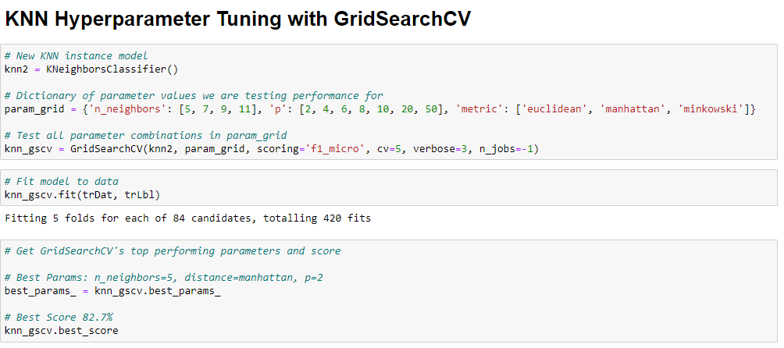
Model -KNN
4 iterations
Dimension Reduction
Hyperparameter tuning with GridSearchCV

Slide 10
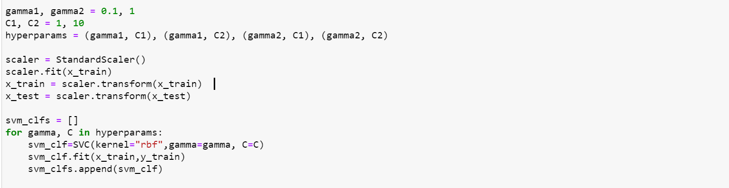
Model - SVM
8 iterations with different combinations of c and gamma
4 rbf kernel
4 poly kernel

Slide 11
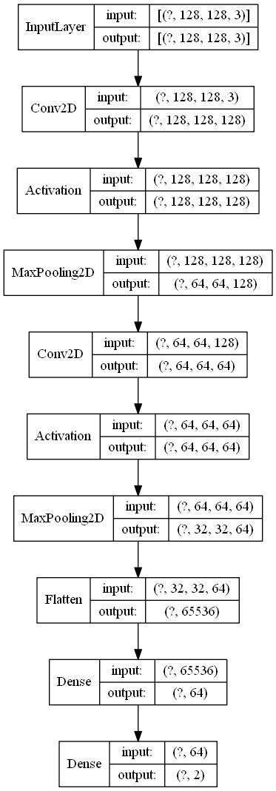
Model - CNN
Activation functions: ReLU, Softmax for last dense layer
8 iterations
○Add more convolutional layers
○Weights Initialization
○Regularize the weight – Overfitting issue resolved
○Dropout
○Batch normalization
○Residual layers
○Learning scheduler – Fast learning step in first 50,
slow in next 50 epochs
○Image augmentation and change batch size – 99.40%
CNN baseline model - Model Plot

Slide 12
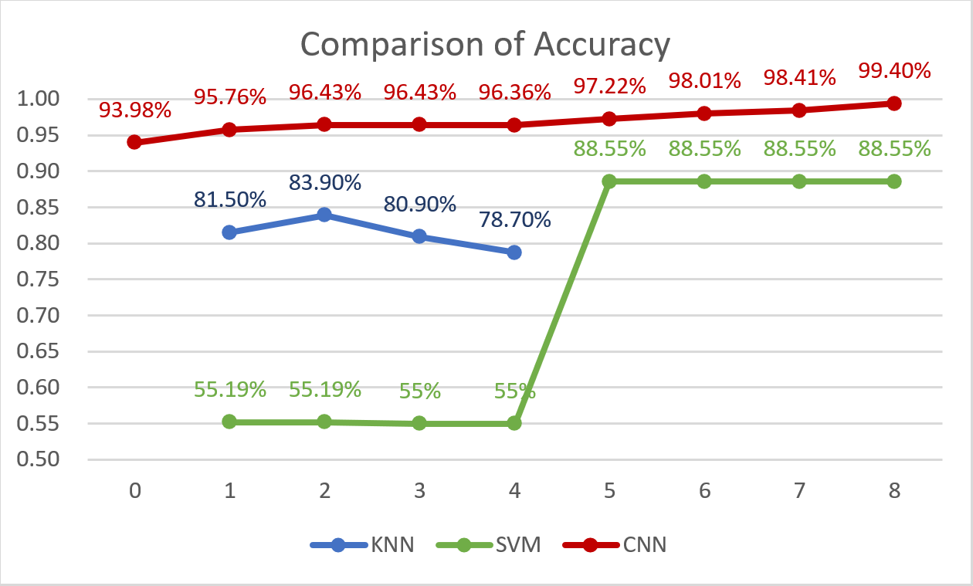
Model Comparison

Slide 13
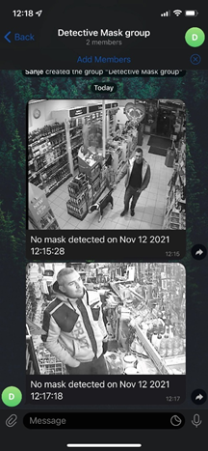
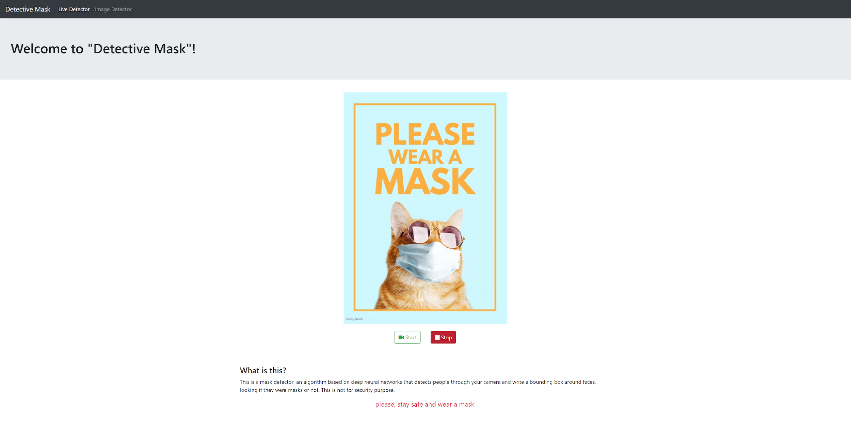
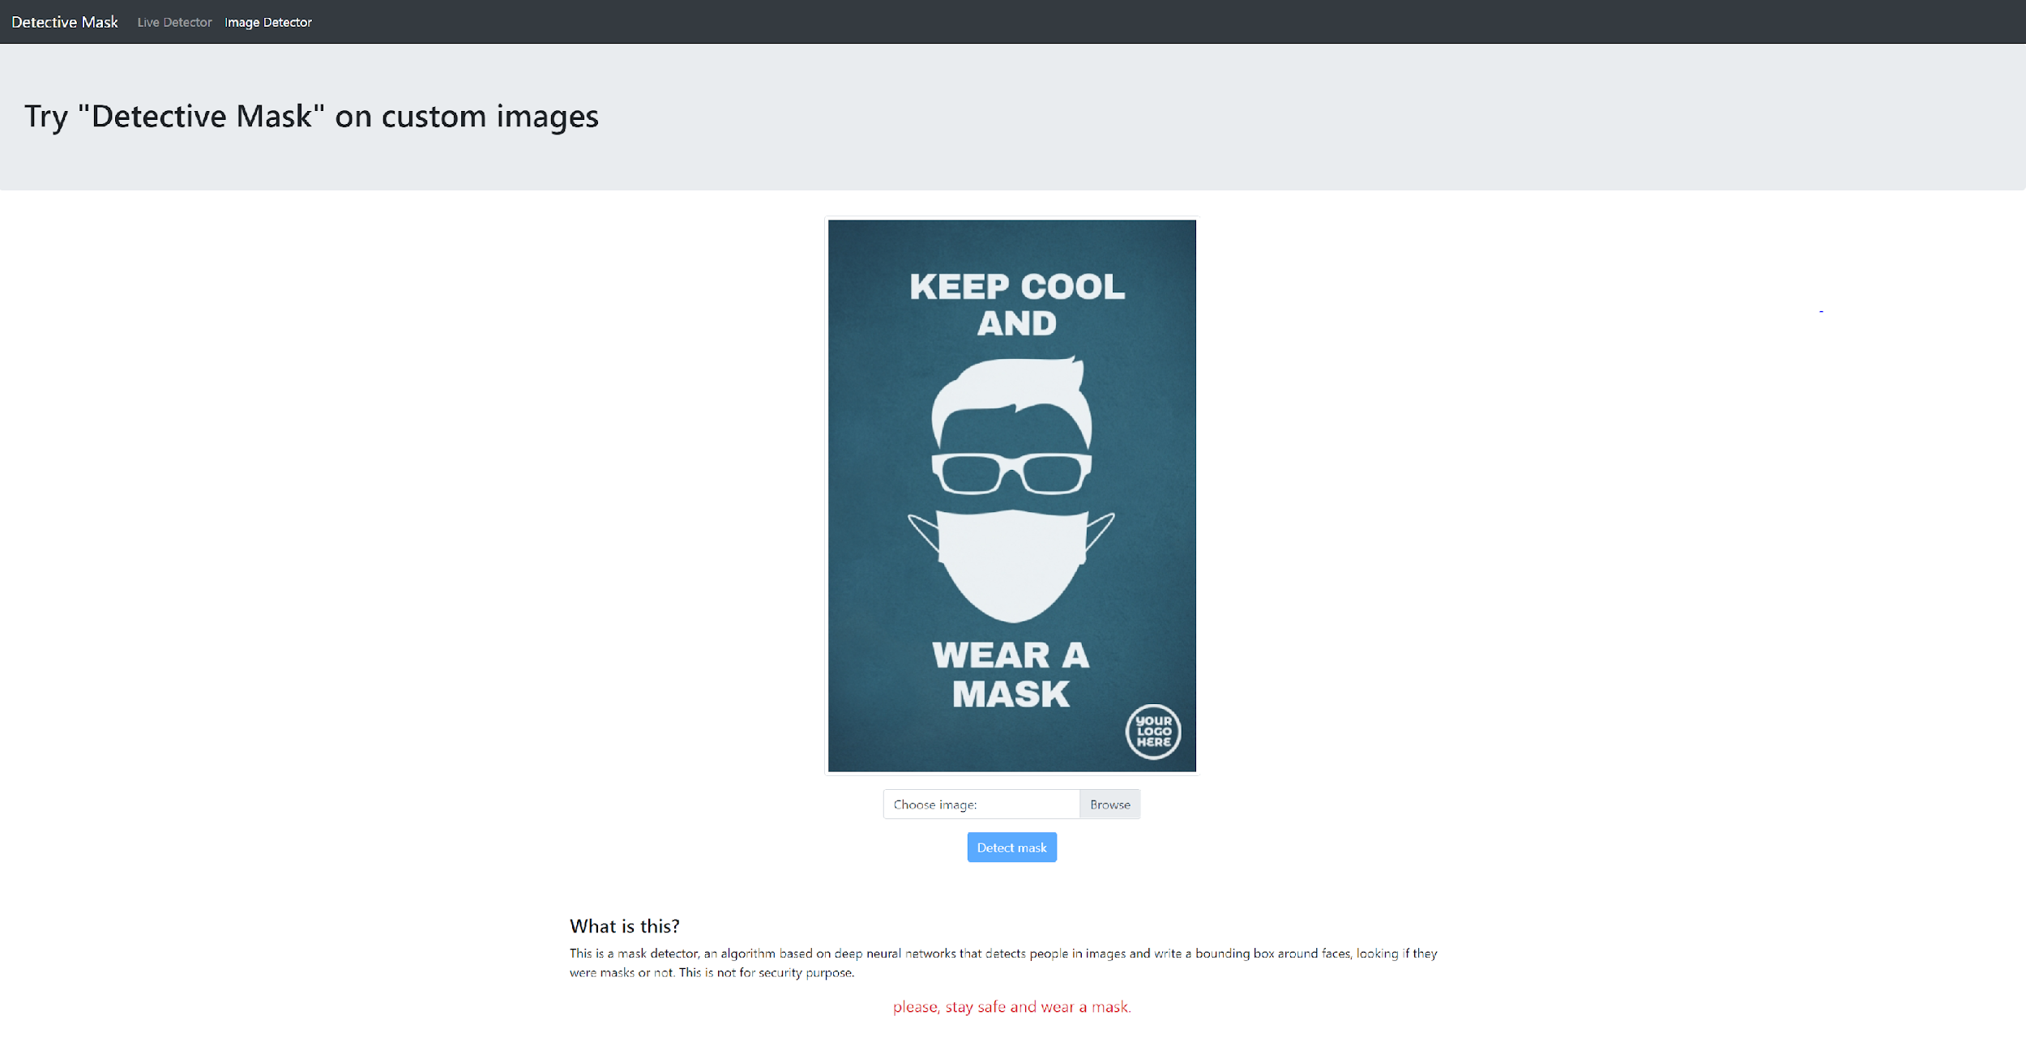
Features
Mask Detection with Live Stream
Mask Detection with Image and Video Upload
Telegram Alerts for people not wearing mask detected

Slide 14

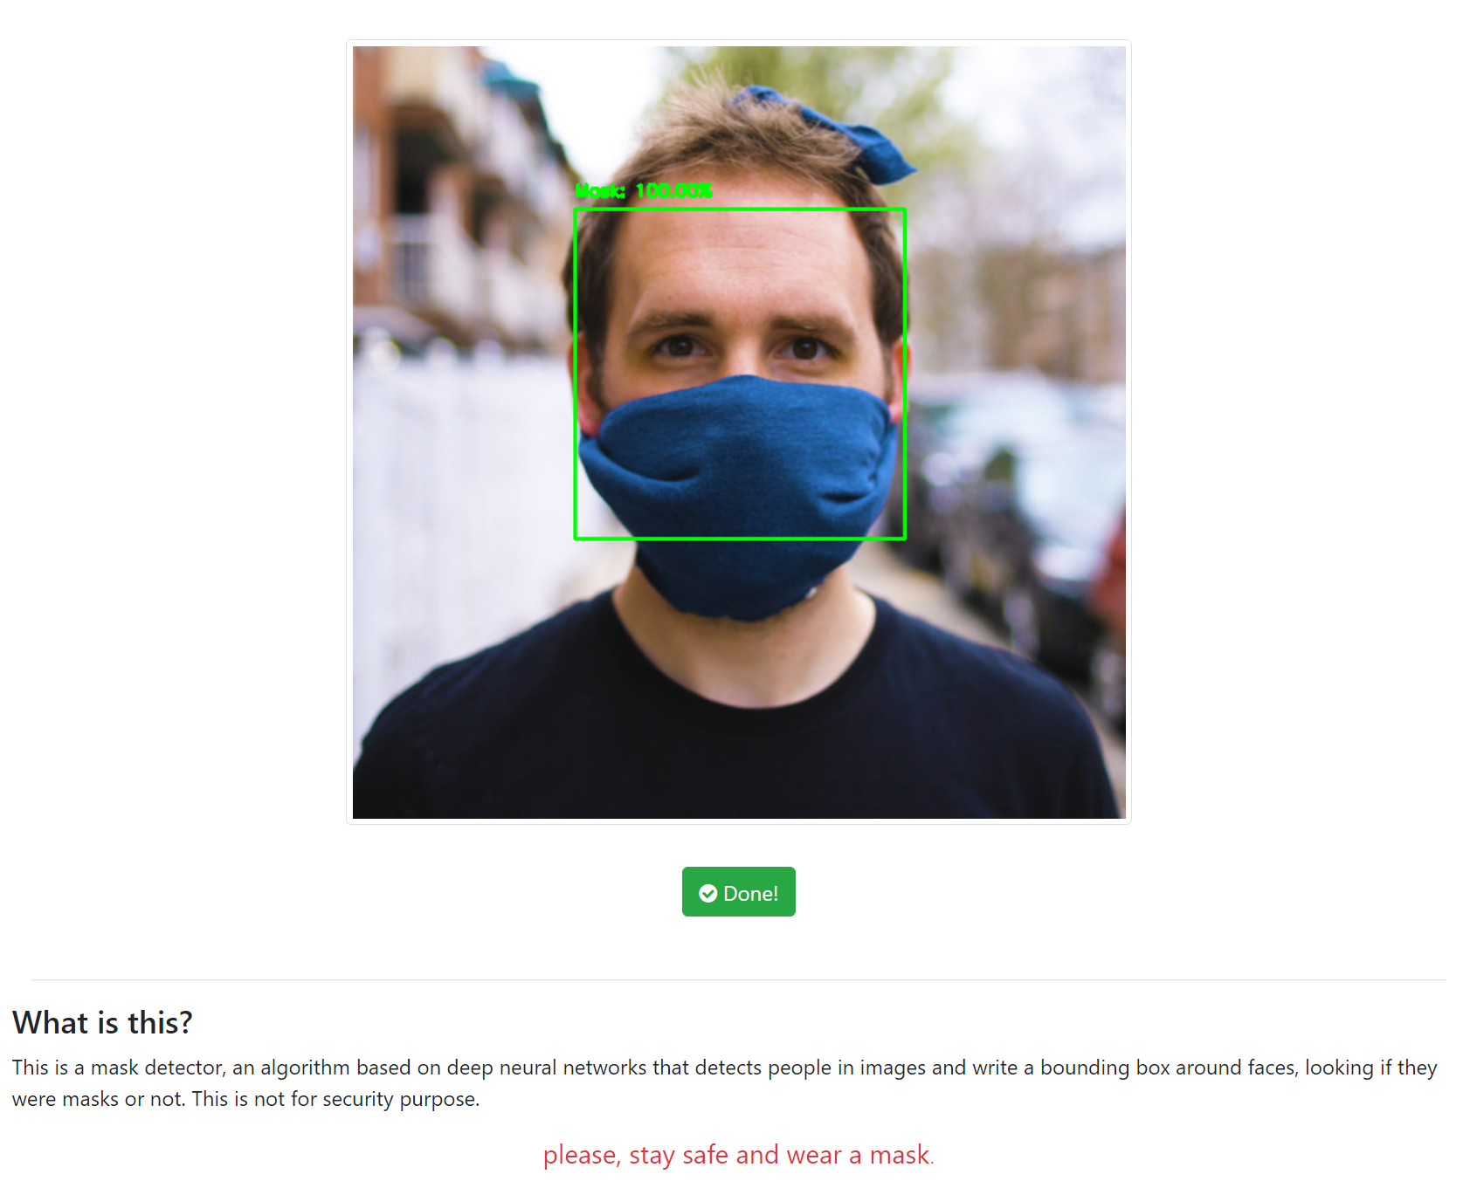
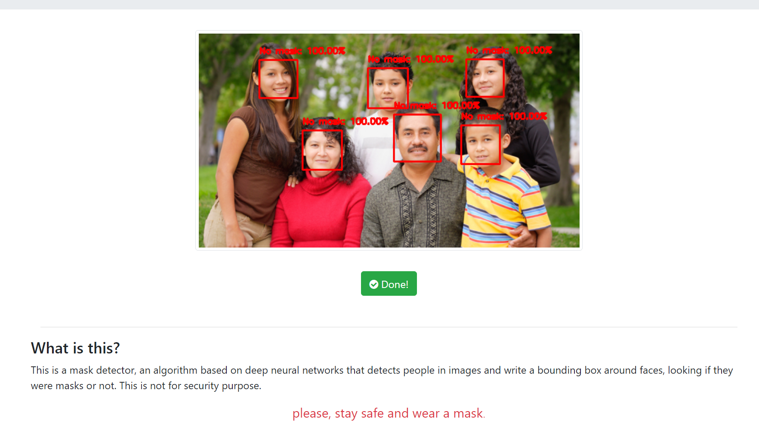
Features
Face Recognition - single face and multiple faces

Slide 15
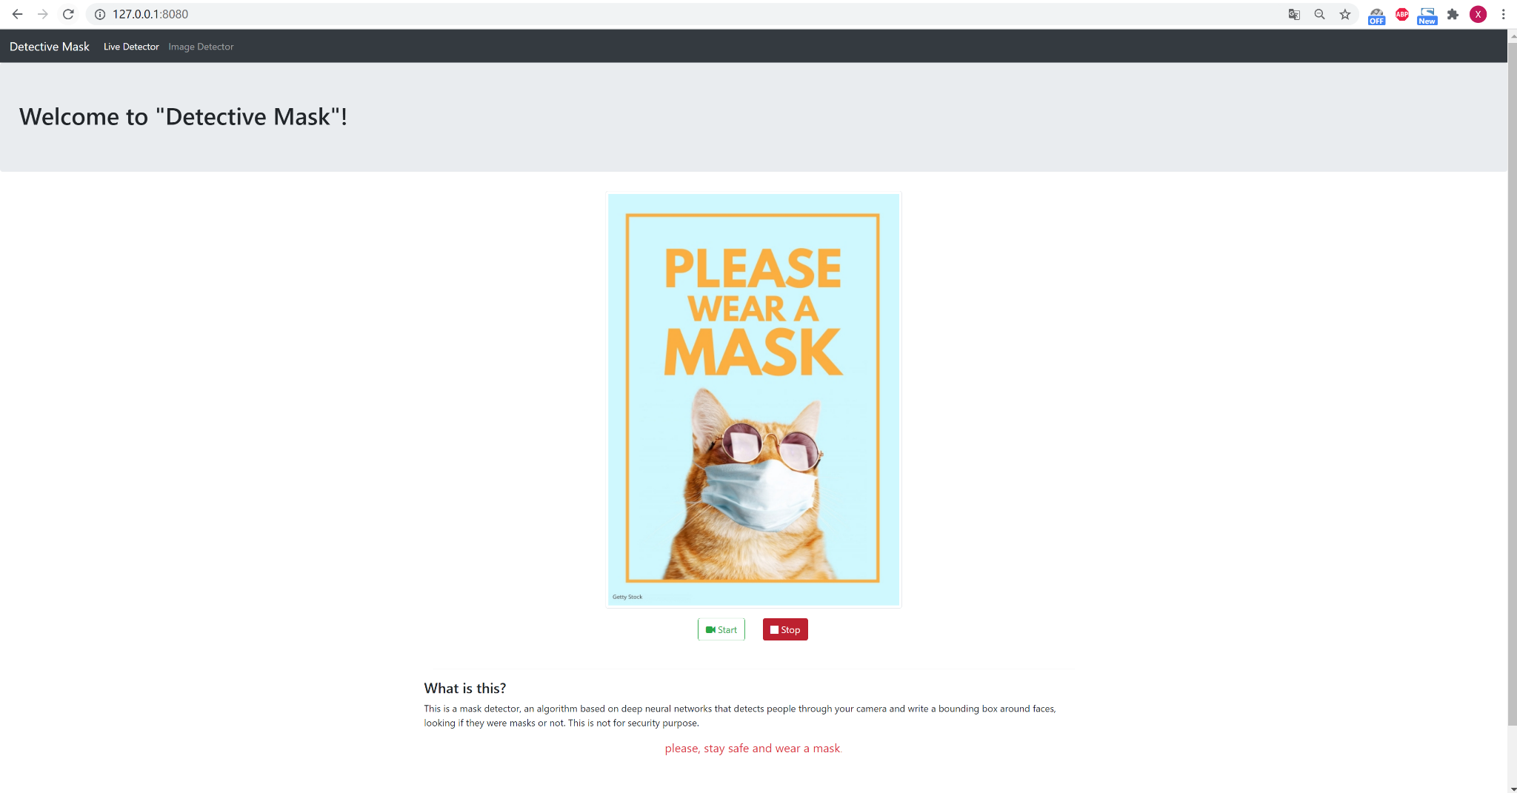
DEMO
Notes:
Demonstrate the current progress of our application and model creation.

Slide 16
Q&A

Slide 17
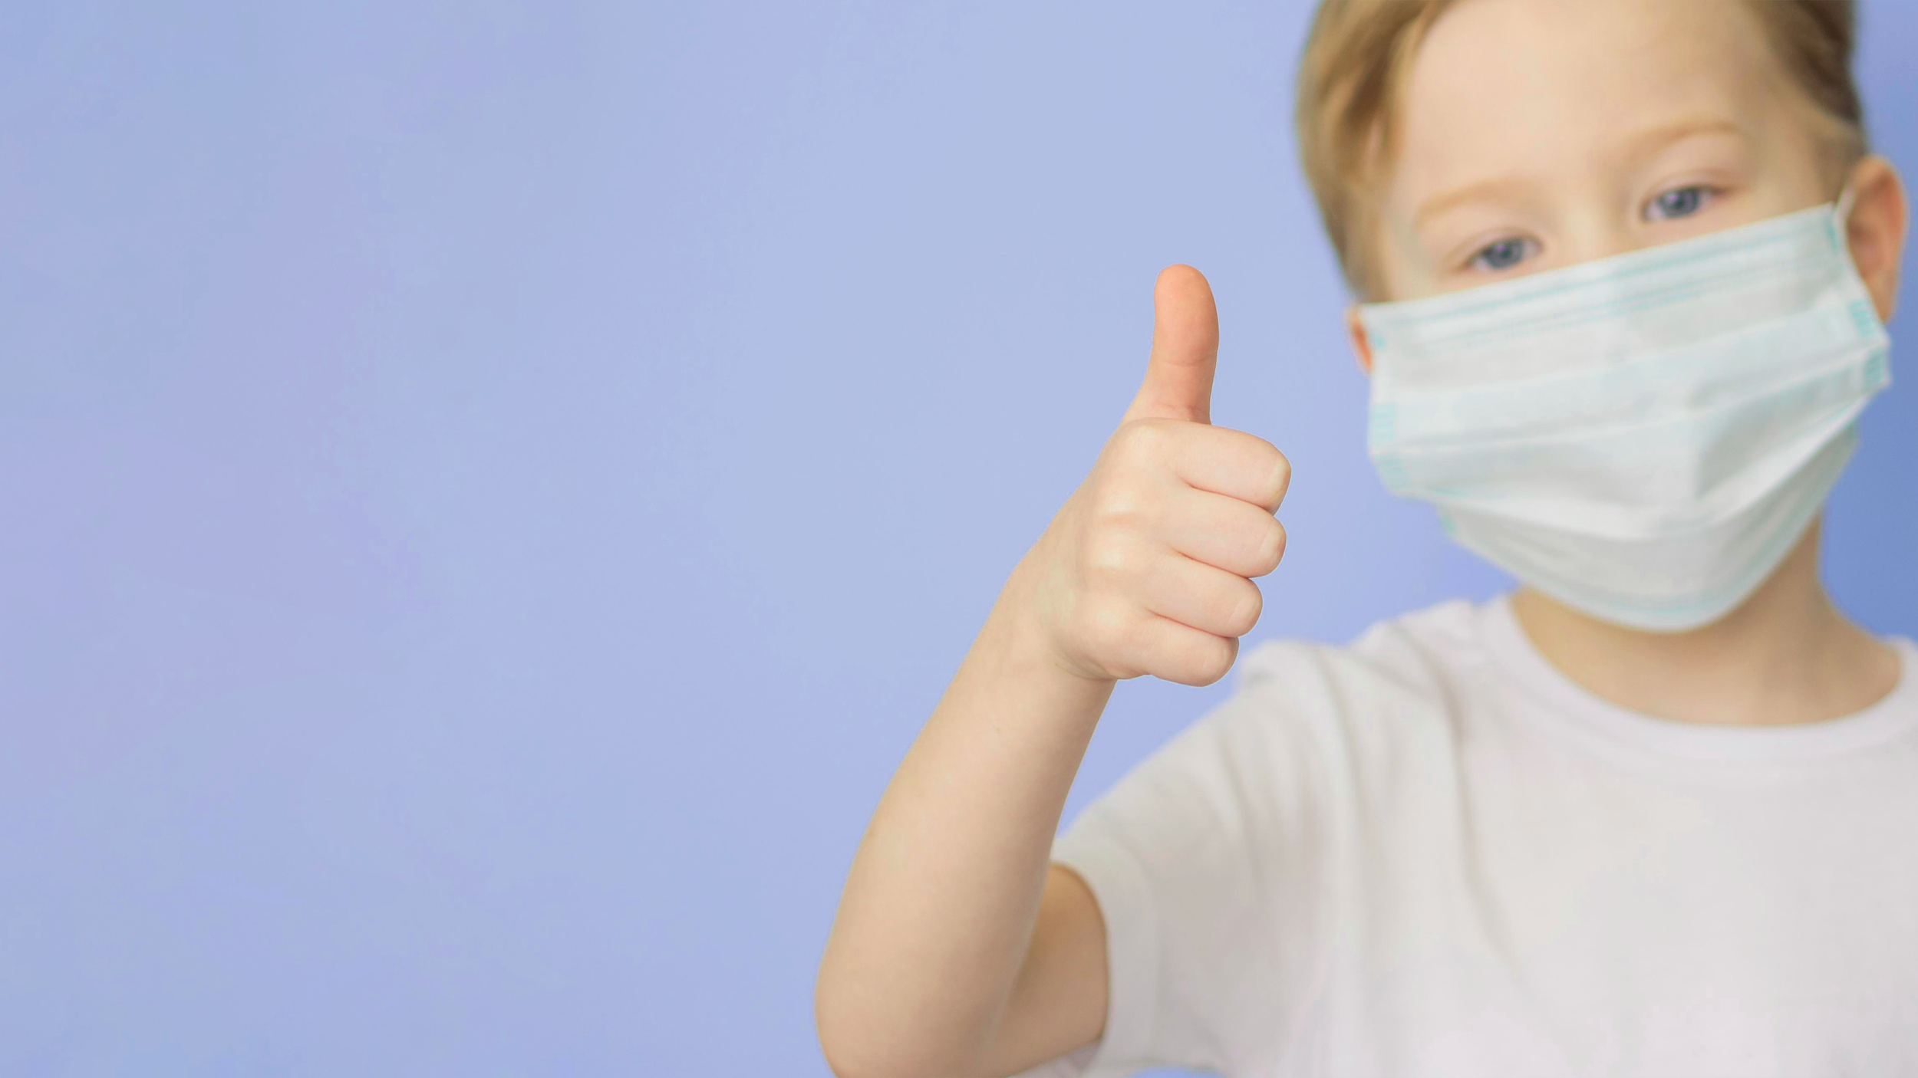
THANKS!
PLEASE REMEMBER TO WEAR A MASK AND STAY SAFE!

